Slide 1

Université de Mostaganem — Dr. Madani BELACEL
TIC COURSE 06
Presentations: Microsoft PowerPoint
Dr. BELACEL Madani
Année universitaire 2026-2027 / Academic Year 2026-2027
Université de Mostaganem - Département Mathématiques et Informatique

Slide 2
Université de Mostaganem — Dr. Madani BELACEL
Course Outline
▪ 1. What Is a Presentation?
▪ 2. Creating and Organizing Slides
▪ 3. Text and Multimedia Objects
▪ 4. Animations and Transitions
▪ 5. Slideshow Mode
▪ 6. Designing Good Slides
▪ 7. Sharing and Distributing

Slide 3
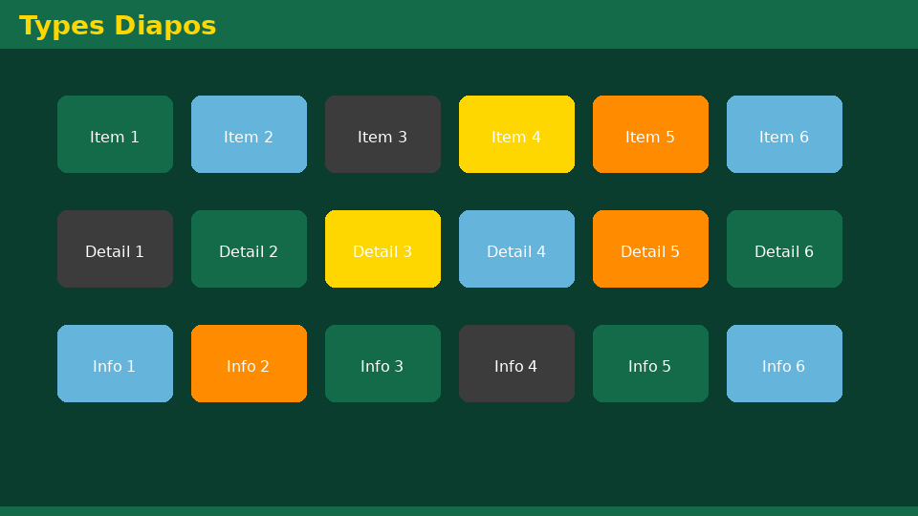
Université de Mostaganem — Dr. Madani BELACEL
Section 1
What Is a Presentation?

Slide 4
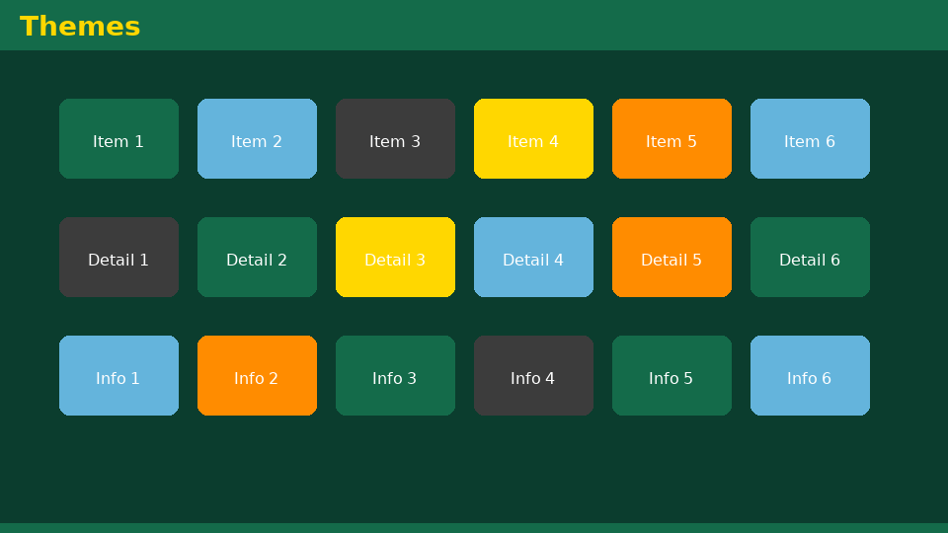
Université de Mostaganem — Dr. Madani BELACEL
1 - What Is a Presentation?
▪ Software for creating animated slideshows.
▪ Visual support for an oral presentation.
▪ Slides combining text, images, sound and video.
▪ Formats: .pptx, .ppsx (slideshow), PDF/video export.

Slide 5
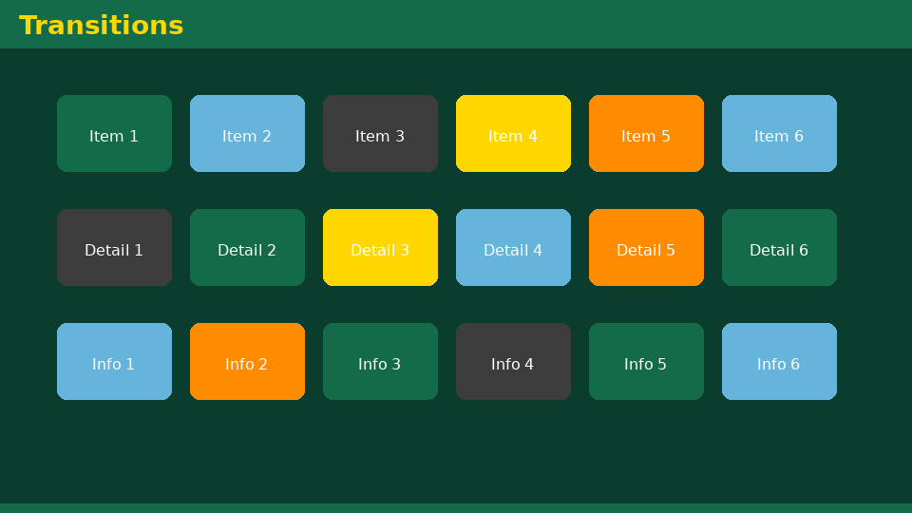
Université de Mostaganem — Dr. Madani BELACEL
Section 2
Creating and Organizing Slides

Slide 6

Université de Mostaganem — Dr. Madani BELACEL
2 - Creating and Organizing Slides
▪ New slide: choose a layout (title, content...).
▪ Slide master: overall visual consistency.
▪ Reorganize: copy, move, duplicate, delete.
▪ Sections to structure a long presentation.
▪ Themes and color variants.

Slide 7

Université de Mostaganem — Dr. Madani BELACEL
Section 3
Text and Multimedia Objects

Slide 8

Université de Mostaganem — Dr. Madani BELACEL
3 - Text and Multimedia Objects
▪ Text boxes: concise titles and bullets (6x6 rule).
▪ Pictures, icons and screenshots.
▪ Embedded or linked video and audio.
▪ Tables and SmartArt graphics.
▪ Hyperlinks between slides or to the Web.

Slide 9

Université de Mostaganem — Dr. Madani BELACEL
Section 4
Animations and Transitions

Slide 10

Université de Mostaganem — Dr. Madani BELACEL
4 - Animations and Transitions
▪ Transitions: effects between two slides (fade, wipe).
▪ Animations: object effects (entrance, emphasis, exit).
▪ Animation order and timing.
▪ Golden rule: keep it sober to stay professional.

Slide 11

Université de Mostaganem — Dr. Madani BELACEL
Section 5
Slideshow Mode

Slide 12

Université de Mostaganem — Dr. Madani BELACEL
5 - Slideshow Mode
▪ Start: F5 (from beginning) / Shift+F5 (current slide).
▪ Navigate: click, arrows, wheel; Esc to quit.
▪ Virtual pen, annotations, black/white screen.
▪ Presenter view: private notes and timer.

Slide 13

Université de Mostaganem — Dr. Madani BELACEL
Section 6
Designing Good Slides

Slide 14

Université de Mostaganem — Dr. Madani BELACEL
6 - Designing Good Slides
▪ Clear structure: title, outline, body, conclusion.
▪ Little text, many visual examples.
▪ Readable contrast: dark background + light text.
▪ Consistent fonts and colors.
▪ Rehearse and time your presentation.

Slide 15
Université de Mostaganem — Dr. Madani BELACEL
Section 7
Sharing and Distributing

Slide 16
Université de Mostaganem — Dr. Madani BELACEL
7 - Sharing and Distributing
▪ PDF export: universal sharing without animation.
▪ MP4 video: self-running presentation.
▪ Online delivery: Teams, Zoom, SharePoint.
▪ File compression: images and media.

Slide 17
Université de Mostaganem — Dr. Madani BELACEL
Practical Interest
▪ Present your projects and talks professionally.
▪ Defenses: a good slideshow highlights your work.
▪ Teaching: pedagogical visual aids.
▪ Business communication: meetings and annual reports.

Slide 18
Université de Mostaganem — Dr. Madani BELACEL
Self-Assessment (MCQ)
1. Which key starts the slideshow from the beginning?
a) F2
b) F5
c) F9
2. A transition applies:
a) To objects on one slide
b) Between two slides
c) To the whole file
3. Presenter view lets you:
a) See your notes
b) Use a timer
c) Both

Slide 19
Université de Mostaganem — Dr. Madani BELACEL
Conclusion
▪ PowerPoint turns ideas into striking visual aids.
▪ Simplicity, structure and readability make quality slides.
▪ Animations must serve the message, not distract from it.
▪ Next course: Internet basics.

Slide 20
Université de Mostaganem — Dr. Madani BELACEL
References
- Microsoft Support - PowerPoint Guide.
- G. Reynolds, "Presentation Zen", Peachpit Press.
- ICT Course materials, University of Mostaganem.
- Presentation community resources.

Slide 21
Université de Mostaganem — Dr. Madani BELACEL
Thank you for your attention!
Questions?
Dr. BELACEL Madani

